Slide 1
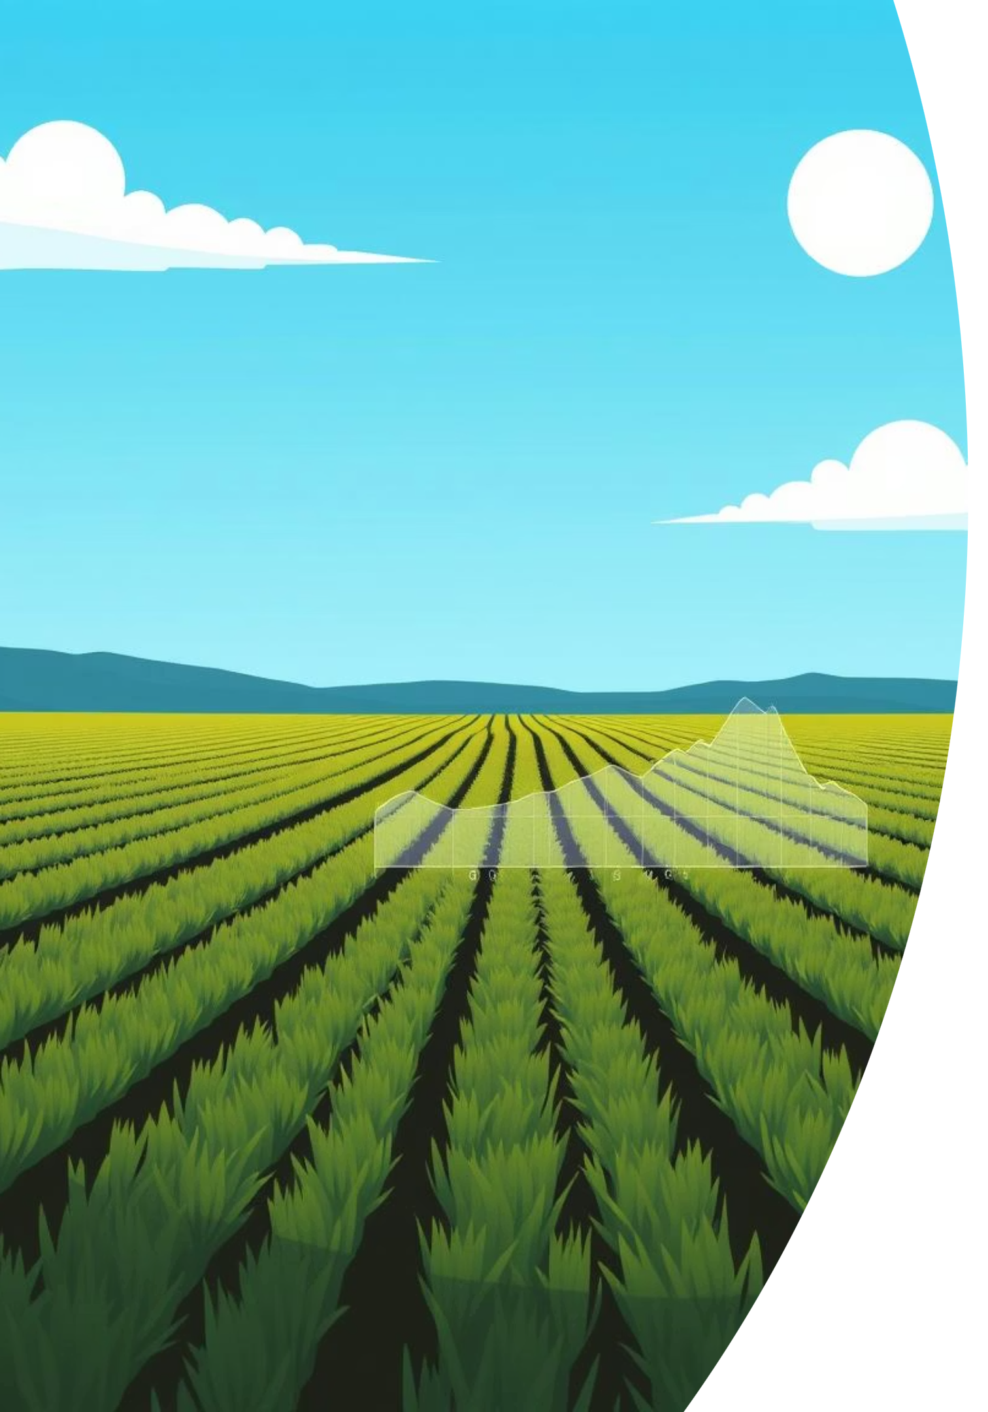
Smart Fields: Crop Recommendations
My Goal : To build a system that helps farmers choose the right crop.
NAME : Pavan S B , Shashank, Asha HR, Amiksha
Team Name : Elite

Slide 2
The Challenge: Why Crop Recommendation Matters
Climate Volatility
Resource Scarcity
Unpredictable weather patterns and changing environmental conditions increase agricultural risk.
Limited land, water, and nutrients necessitate optimized crop selection for maximum yield.
Suboptimal Yields
Data-Driven Decisions
Traditional farming methods often lead to inefficient crop choices and reduced profitability.
Farmers need actionable insights to make informed decisions about which crops to cultivate.
Farmers face immense challenges; our system provides a data-driven solution for sustainable agriculture.

Slide 3
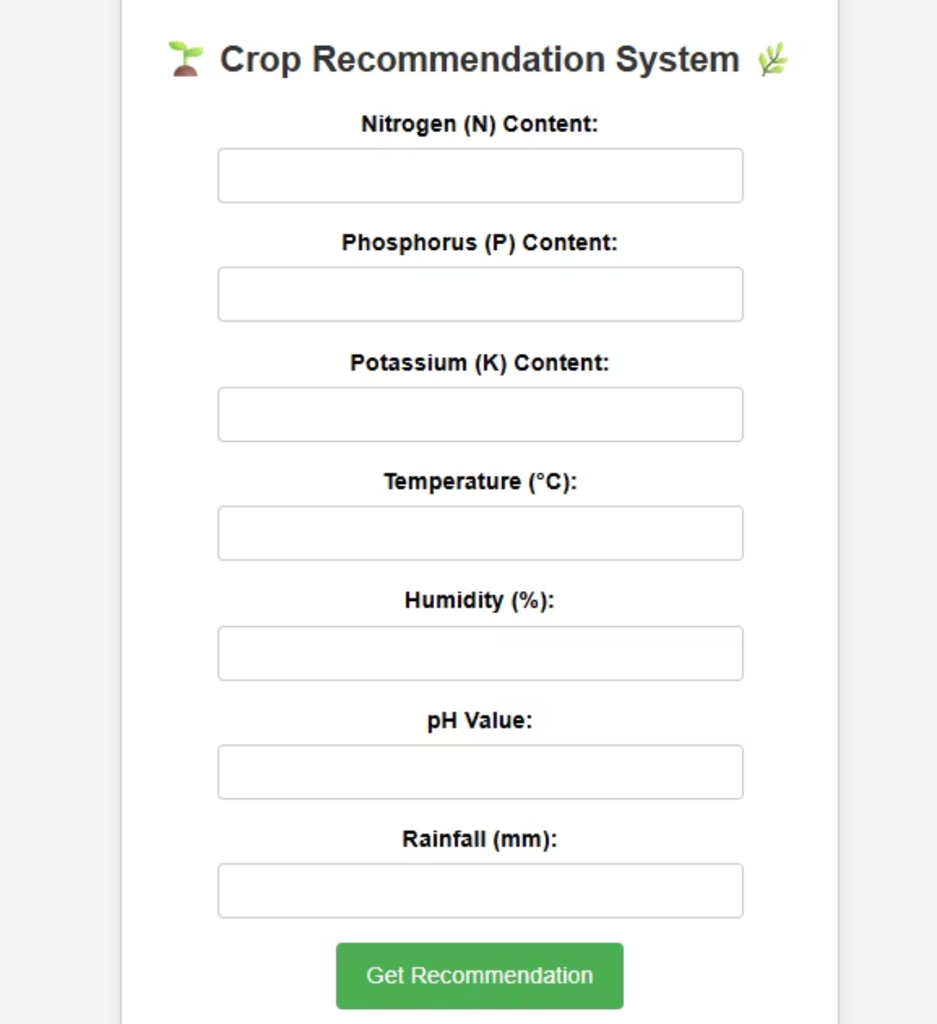
Our Solution: An Intelligent Crop Advisor
We developed a Crop Recommendation System utilizing Machine Learning to guide farmers toward optimal crop choices.
At its core, the system employs a Random Forest Classifier, a powerful ensemble learning method, to analyze various environmental factors. The entire application is built with Flask, a lightweight Python web framework, providing an intuitive user interface for farmers.

Slide 4

Understanding the Brain: Random Forest Classifier
1
Ensemble Learning
Combines multiple decision trees to improve prediction accuracy and robustness.
2
Feature Importance
Identifies which environmental factors (e.g., nitrogen, pH, temperature) are most crucial for crop growth.
3
Handles Complex Data
Effectively manages diverse agricultural datasets, including numerical and categorical features.
The Random Forest Classifier provides high accuracy and handles complex relationships within the agricultural data.

Slide 5
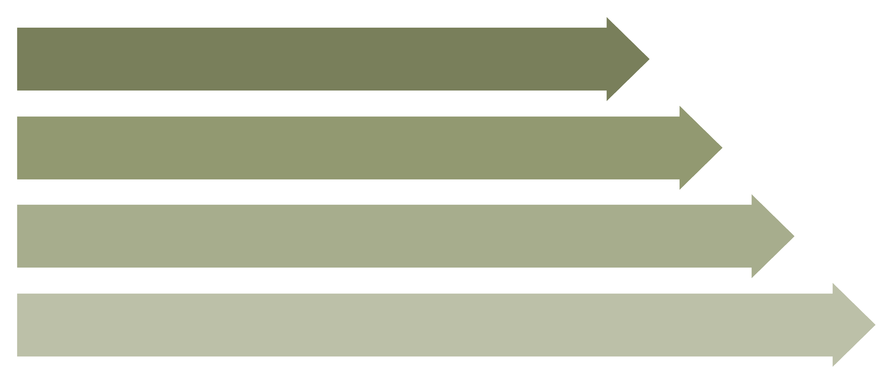
The Workflow: From Data to Recommendation
Data Input
Preprocessing
Model Training
Web App Output
This streamlined workflow ensures accurate and timely crop recommendations based on farmer-provided data.

Slide 6



Key Components: Data, Model, and Application
Agricultural Data
Trained ML Model
Flask Web App
Our system relies on comprehensive datasets including soil nutrients (N, P, K), pH levels, rainfall, temperature, and humidity for various regions.
The Random Forest Classifier, meticulously trained on historical agricultural data, identifies patterns and correlations to predict optimal crop types.
A user-friendly web interface, built with Flask, allows farmers to easily input their field's parameters and receive instant crop recommendations.
Each component is vital for the system's ability to deliver accurate and accessible crop recommendations.

Slide 7
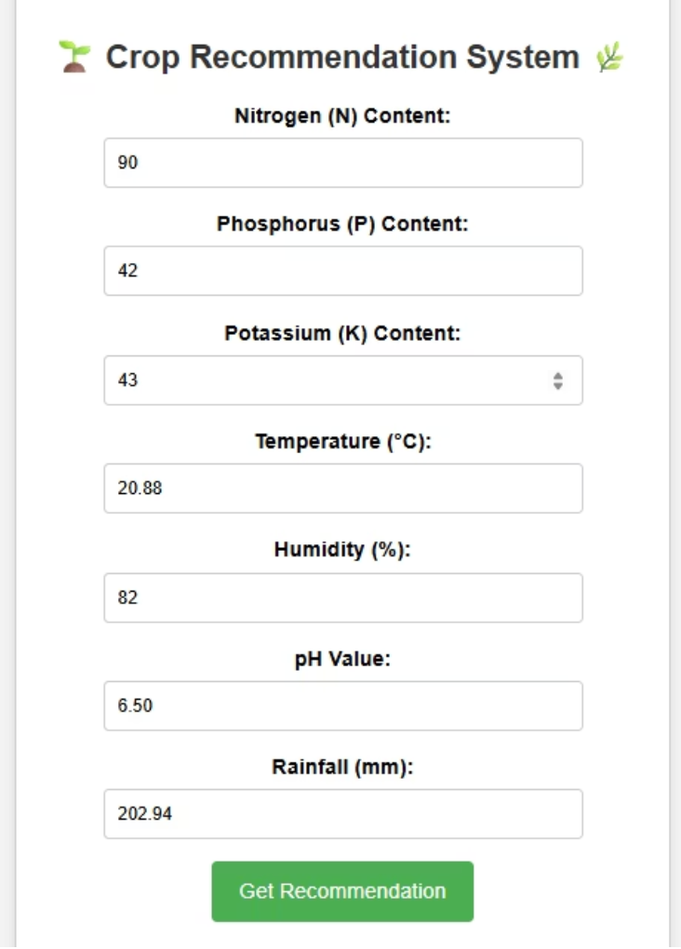
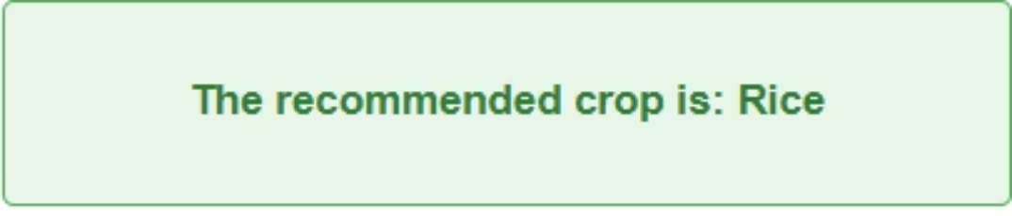
Live Demo: Experience Smart Farming
Imagine a farmer enters specific details about their land: Nitrogen (N), Phosphorus (P), Potassium (K) levels, pH, rainfall, temperature, and humidity.
Upon submission, the Flask application processes this input through our trained Random Forest model. Within seconds, it outputs the most suitable crop, along with the confidence score, directly on the web page. This real-time feedback empowers farmers to make informed decisions quickly.

Slide 8
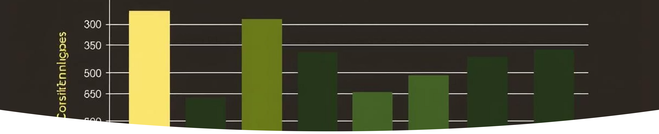
Predicted Results: Optimized Crop Choices
The system doesn't just recommend; it provides insights into why a certain crop is ideal, considering all input parameters. This is a typical output a farmer would see after inputting their field's data.
"Based on your soil conditions (N: 90, P: 42, K: 43), pH (6.5), rainfall (203mm), temperature (23°C), and humidity (82%), the ideal crop is Rice with 95% confidence."

Slide 9




Future Horizons: Enhancing the System
Satellite Imagery
More Data Sources
Integrate satellite data for real-time field monitoring and larger-scale recommendations.
Incorporate additional soil analysis, weather forecasts, and historical yield data.
Advanced Algorithms
Economic Factors
Experiment with deep learning models for even greater predictive accuracy.
Add market prices and cost analysis to recommend the most profitable crops.
Our system is a foundation for continuous innovation in precision agriculture.

Slide 10

Thank You
Questions? We believe in nurturing the future of farming with smart technology.
Empowering farmers for a sustainable tomorrow.

